Slide 1
Uberconf
June 19th – 22nd
July 19th, 2012

Slide 2


Great workshops. Wonderful opportunity.
Well known industry experts teaching you.
Right from open source developers.
Many thanks to Staples, Uday & Rick!
Truly inspirational.

Slide 3
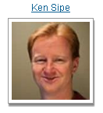
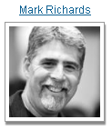
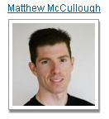
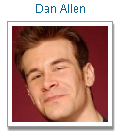
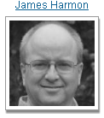
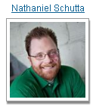
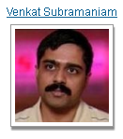

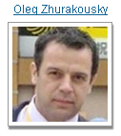
Many Respected Speakers
Former CTO Gradleware
@kensipe
Building and Testing with Gradle Trainer at Github
@matthewmccull
Author: Seam in Action Jboss – Seam3 Tech Lead
http://mojavelinux.com @mojavelinux
Using DOJO Javascript Library Android Trainer
@ntschutta
Professor at University of Houston Pragmatic Bookshelf Book Author Practices of an Agile Developer @venkat_s
Author: Spring in Action
@habuma

Slide 4
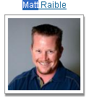
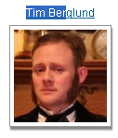
Right in our backyard
Raibledesigns.com
Co-Founder App Fuse

Slide 5

Whole Day workshops – 6
Half Day Workshops – 25
Sessions – 110
Total - 141
Simultaneous Sessions – 9 (at Max)
Day1 – 6 Slots
Day 2 – 5 Slots
Day 3 – 4 Slots
Total – 15.
Percent - ~10%
You’ve got to be kidding me!

Slide 6


Slide 7


Sheldon Zone - Jargon Alert!
Sheldon Cooper
Big Bang Theory

Slide 8
I warned you
Mobile (Android, IOS, Native vs Web)
Architecture (Domain Driven Design, Enterprise Architecture, Patterns)
Security
Cloud, SOA & ESB
Agile
Version Control Systems (Git)
Programming (Grails, Spring, Clojure, HTML5, Javascript, Groovy, Scala, Jruby, Scala, Akka, Jboss Forge, Play Framework, Javascript MVC spine.js)
Databases (NoSQL, Neo 4j, MongoDB)
Search (Hadoop, Solr)
Build - Infrastructure (Sonar Code Metrics, Gradle, Continuous Integration Jenkins)
Testing (Mockito, Spock, Geb)
MQ (Apache Active MQ, Spring Cloud MQ)

Slide 9










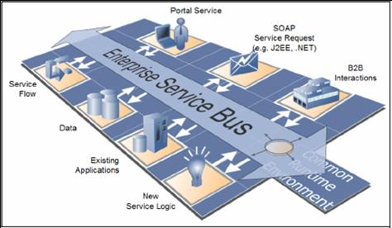









Bit Better?

Slide 10

Sessions
Workshop Day1: [ 9am – 6pm ]
Android Workshop
Day 2:- [8:30 am – 10 pm]
Scala For the Intrigued – Venkat Subrahmaniam
Sonar Code Metrics Workshop – Matthew McCullough
Neo4j Workshop – Tim Berglund
Native Apps vs. The Mobile Web – Nathaniel Schutta
Mongo DB – Ken Sipe
Keynote Speech – JVM Languages – Venkat Subrahmaniam
Redhat Forge – Dan Allen
10

Slide 11
Sessions
Day 3:- [9am – 6:30pm]
Hacking Workshop – Ken Sipe
HTML5 with Play, Coffee Script &Jade – Matt Raible
Mastering Javascript - Venkat Subrahmaniam
Automated Testing For Javascript - Venkat Subrahmaniam
Mobile Development Options – Pratik Patel
Day 3:- [9am – 4:45pm]
Messaging in the cloud – Oleg Zhurakousky
Solr Recipes Workshop - Erik Hatcher
Clojure – Tim Berglund
Spine.js – Craig Walls

Slide 12

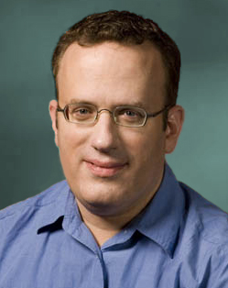



Javascript
1. Father of Javascript: Brendan Eich
2. @Netscape Communications
3. Is omni-present now.
I. var max = function(a, b){ if(a > b) return a; return b; }
console.log(max(1, 2, 3)); -- Ignores the third parameter.
II. Equality (In Equality) Problem if(x = y+z) -> always true big problem. Except when y+z = 0 or “”
console.log(2.0 == “2.0”); -> is true. - Is a problem. (== Doesn’t check type equality) console.log(2.0 === “2.0”) -> is false - which is better. So, use three equals.
IV. Do coffeescript than javascript. Has ruby like syntax. jslint use it for figuring out code quality. Js hint is kinder.
III. Prototypes – Work like pointers in C.
Allows multiple inheritance.

Slide 13
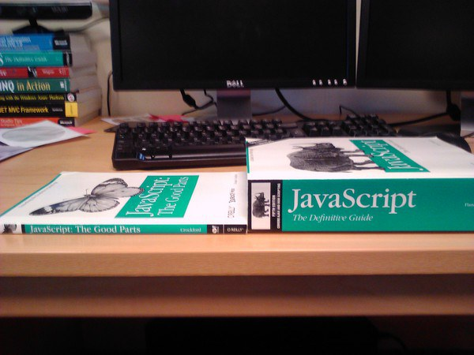
Bad Parts - Javascript
Language was designed in 10 days.
Named Javascript to benefit from Java’s popularity
GWT treats javascript as a bug.
Very easy to shoot yourself in the leg if not careful.
No concept of block scope. Inside curly braces.. Everything becomes global.

Slide 14
Android

Slide 15
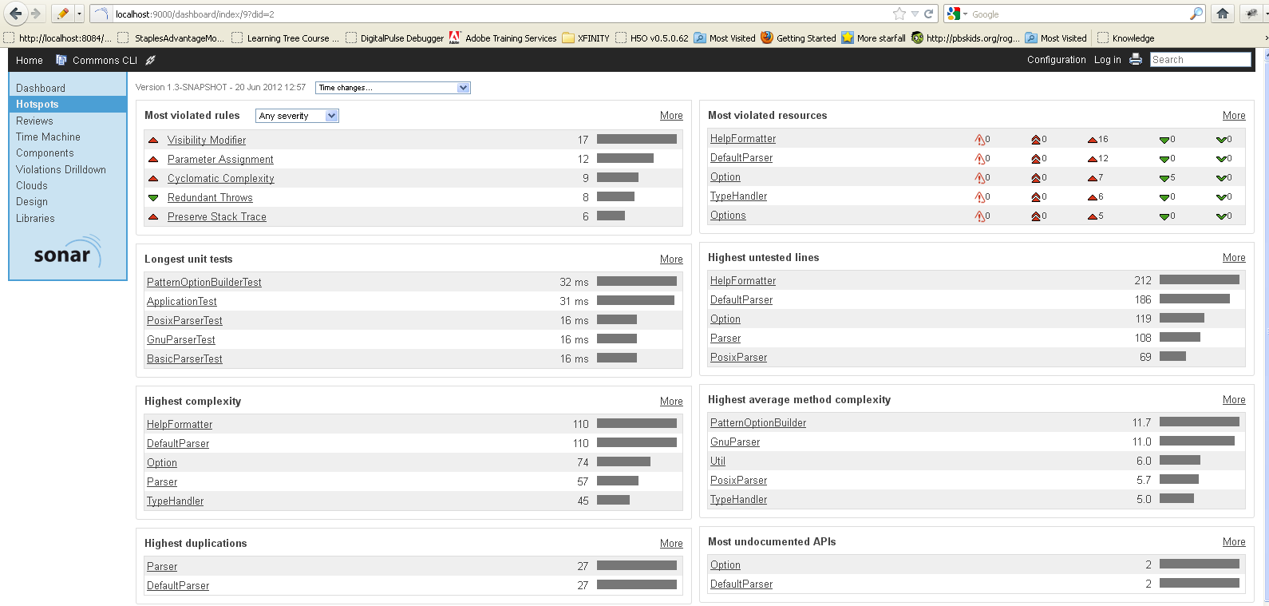
Sonar – Code Quality Control Automation
C:\Sonar\sonar-3.0\bin\windows-x86-32\startsonar.bat
http://localhost:9000
Go to your project: mvn sonar:sonar

Slide 16
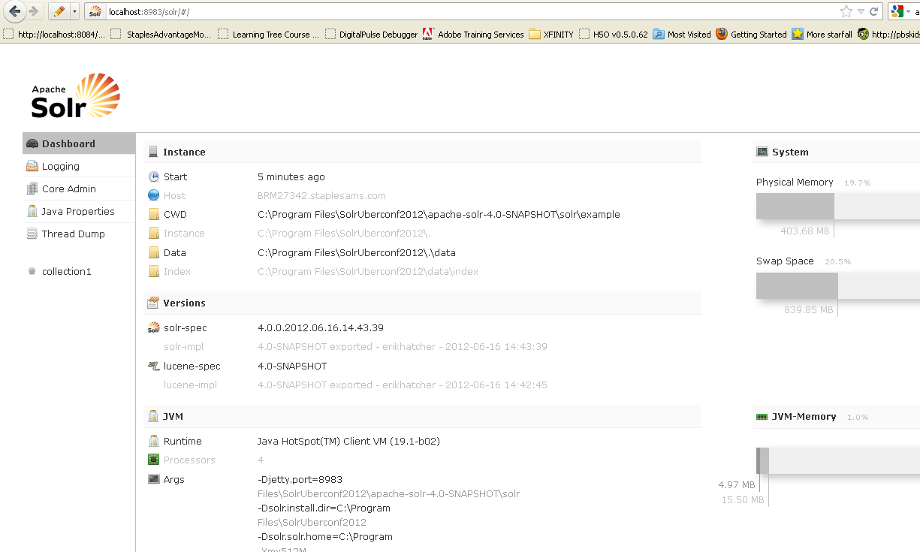
Solr – Lucene – Search Engine
From C:\Program Files\SolrUberconf2012\:- ant start-solr
http://localhost:8983/solr
Loading Data: java -Dtype=text/csv -jar post.jar books.csv
Search URL’s: http://localhost:8983/solr/select?q=*:*
http://localhost:8983/solr/collection1/browse?q=name:game&debug=true&wt=xml

Slide 17
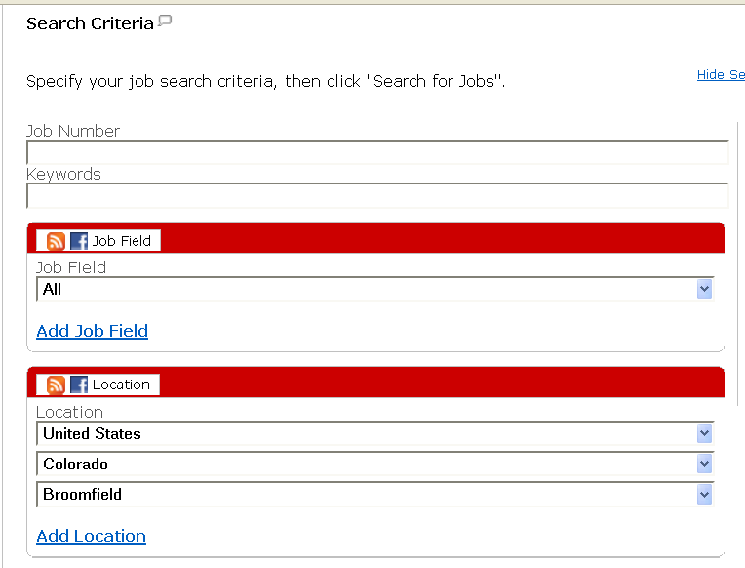
Putting into practice
Learn by doing.
Pick a problem
Something useful in real life.
No mobile career site
Define improvements.
Search can be better
Do not wait for hardware
Start Coding

Slide 18
Traditional Enterprise Architecture
Desktop
Mobile
Desktop
Frameworks
Mobile
Service Tier – Business Logic & Search
Heavy EJB’s
DB
DB2/Oracle
(1000 of $’s per cpu)
Server Hardware
HP/DELL Servers with AIX
(Problem: Not Elastic)

Slide 19
New Architecture
Desktop
Mobile
Desktop
Mobile
Service Tier – Business Logic & Search
Light weight Rest Services + Mongo Native ORM support
DB
Mongo DB free
Server Hardware
Cloud – Amazon/ Rackspace/ Heroku or Staples Virtual Solutions

Slide 20
Aim
Parse Job XML Data
Scala
Android + Phone Gap App (Cordova)
Cloud Heroku
Mongo DB
Play framework
Rest JSON Service
Solr Search

Slide 21
Reality - Scaled down aim
Parse Job XML Data
SAX
Android + Phone Gap App (Cordova) + Jquery Mobile
Desktop site
With Jquery Datatable Plugin
Amazon EC2
Mongo DB
Jersey on Tomcat Rest JSON Service
Solr Search

Slide 22
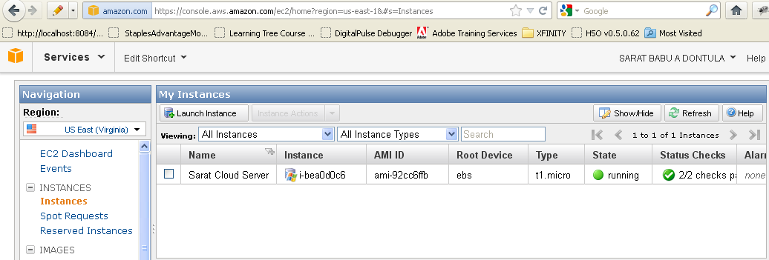
Hardware – Cloud to the Rescue
Going to Cloud:
Purpose servers on the fly. (Elastic)
Utilize cloud capacity for peak season.
Cloud as a form of Disaster Recovery.
Amazon EC2
Rack Space
Heroku

Slide 23
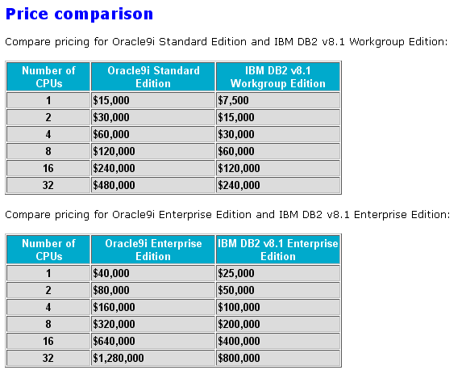
Maximize Investment on Database
IT wants to minimize DB costs.
Would love to see the cpu utilization on the DB to stay low.
Are we making effective usage of our DB?
Can some low priority data be off-loaded / externalized?
We want to store ever changing deals information.
Ratings information?
Want to store extra meta data about an order.
Solution?
Use inexpensive DB’s for non-critical data items.
Mongo DB provides very fast reads.
Can be clustered easily.
Its free.
Data from:- http://www.mssqlcity.com/Articles/Compare/oracle_vs_db2.htm

Slide 24
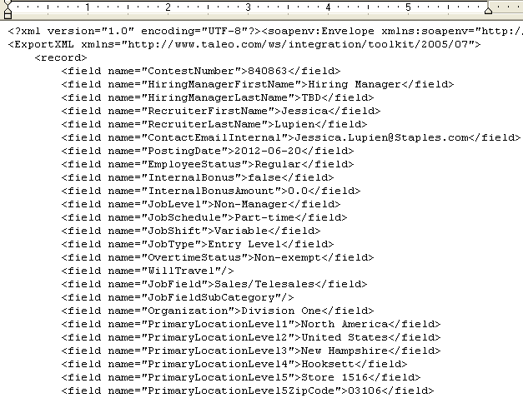
Careers Data

Slide 25
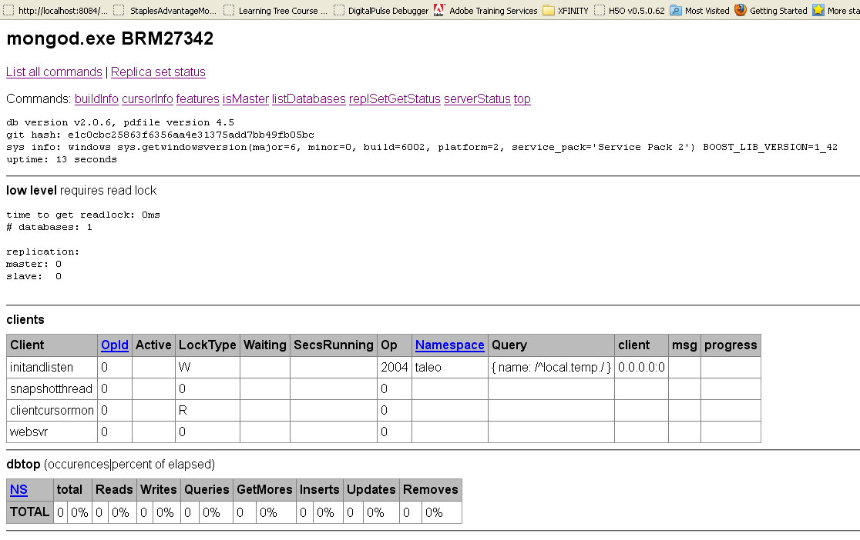
Mongo Console

